Slide 1

Introduction to Logistic Regression
Presented by:
Elizer Ponio Jr.
Department of Computer Science
College of Computing and Information Technologies

Slide 2
Outline
What is Logistic Regression?
Comparing Linear and Logistic Regression

Slide 3
Obese
Logistic Regression is similar to Linear Regression except…
Not Obese
1
2
3

Slide 4
Obese
Logistic Regression predicts whether something is True or False, instead of predicting something continuous like price.
Not Obese
1
2
3

Slide 5
Obese
These people are obese
These people are not obese
Not Obese
1
2
3
Weight

Slide 6
Obese
For this example, we cannot use Linear Regression and fit a straight line because it won’t tell us if someone is obese or not.
Not Obese
1
2
3
Weight

Slide 7
Obese
Instead of fitting a straight line to the data, logistic regression fits an “S” shaped logistic function
Not Obese
1
2
3
Weight

Slide 8
1
The curve goes from 0 to 1
0
1
2
3
Weight

Slide 9
1
The curve tells you the probability that a person is obese based on its weight.
0
1
2
3
Weight

Slide 10

Obese
If we weighed a very heavy person
Not Obese
1
2
3
Weight

Slide 11
Obese
There is a high probability that this person is obese.
Not Obese
1
2
3
Weight

Slide 12
Obese
If the person has an average weight
Not Obese
1
2
3
Weight

Slide 13
Obese
Then there is only a 50% chance that this person is obese.
Not Obese
1
2
3
Weight

Slide 14
Obese
Not Obese
1
2
3
Weight

Slide 15
Although logistic regression tells the probability that a person is obese or not, it’s usually used for classification
Obese
Not Obese
1
2
3
Weight

Slide 16
In logistic regression, there is a threshold or decision boundary that separates two classes.
Obese
Not Obese
1
2
3
Weight

Slide 17
For example, if the probability of a person is greater than 50%, then we will classify it as obese, otherwise we will classify it as not obese
Obese
Not Obese
1
2
3
Weight

Slide 18
Just like Linear Regression, we can make a simple model..
Using only weight to predict Obesity
Obese
Not Obese
1
2
3
Weight

Slide 19
Or more complicated models..
Using weight, height, age and blood type to predict obesity
Obese
Not Obese
1
2
3
Weight

Slide 20
In other words, just like linear regression, logistic regression can work with continuous data (weight, height, age) and discrete data (blood type)
Obese
Not Obese
1
2
3
Weight

Slide 21
Logistic Regression’s ability to provide probabilities and classify new samples using continuous and discrete data makes it a popular machine learning method.
Obese
Not Obese
1
2
3
Weight

Slide 22
One big difference between linear and logistic regression is how the line is fit to the data
Obese
Not Obese
1
2
3
Weight

Slide 23
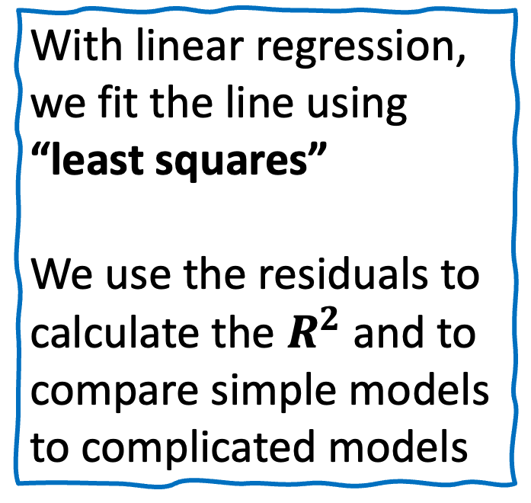
With linear regression, we fit the line using “least squares”
We use the residuals to calculate the $R^{2}$ and to compare simple models to complicated models
Jeepney Fare (Y)
Price of Fuel (X)

Slide 24
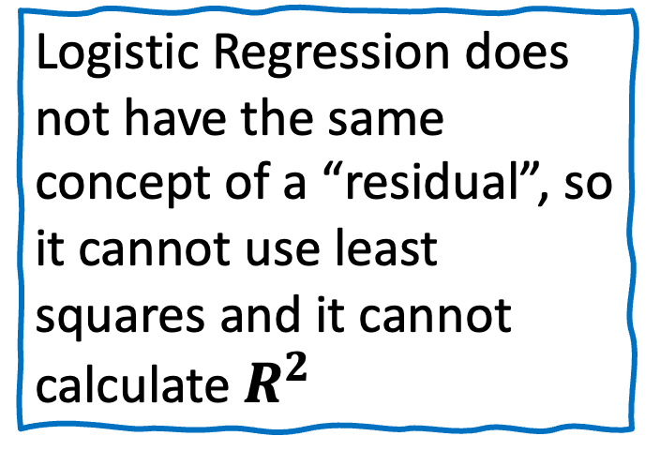
Logistic Regression does not have the same concept of a “residual”, so it cannot use least squares and it cannot calculate $R^{2}$
Obese
Not Obese
1
2
3
Weight

Slide 25
Instead, it uses something called “Maximum Likelihood”
Obese
Not Obese
1
2
3
Weight

Slide 26
Logistic Function
The name “logistic regression” is derived from the concept of the logistic function that it uses.
The logistic function is also known as the sigmoid function.
The value of this logistic function lies between 0 and 1, which cannot go beyond this limit, so it forms a curve like an “S” form.

Slide 27
Linear Regression | Logistic Regression
It is used for solving regression problems | It is used for solving classification problems
We find best fit line. | We find S-Curve.
Least square estimation method is used for estimation of accuracy. | Maximum likelihood estimation method is used for estimation of accuracy.

Slide 28
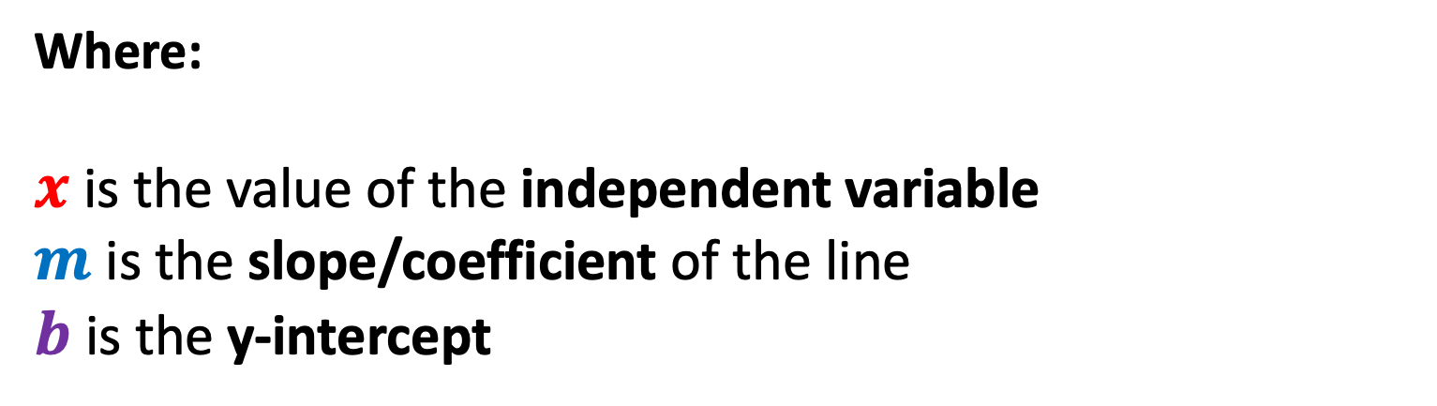
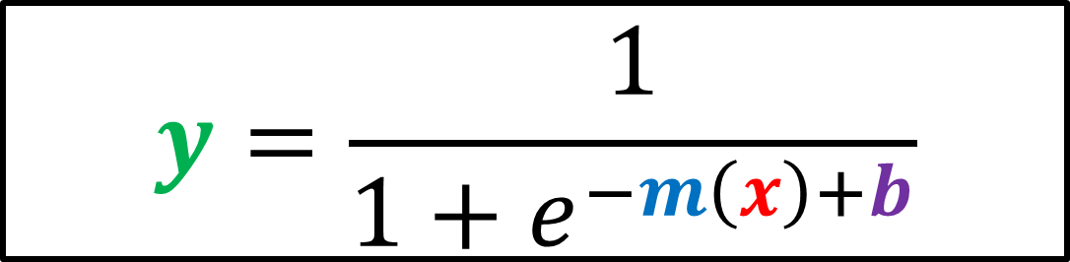
Logistic/Sigmoid Function
$$y=\frac{1}{1+e^{−m\left(x\right)+b}}$$
Where:
$x$ is the value of the independent variable
$m$ is the slope/coefficient of the line
$b$ is the y-intercept

Slide 29
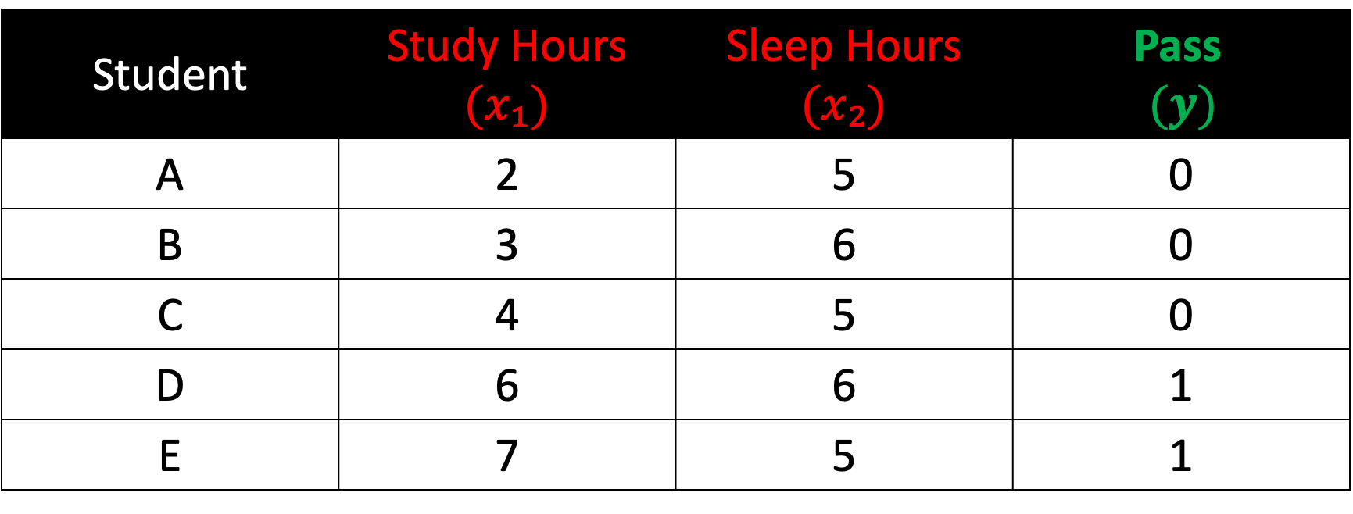
Example: Predicting if a Student will Pass or fail
Student | Study Hours $(x₁)$ | Sleep Hours $(x₂)$ | Pass $$(y)$$
A | 2 | 5 | 0
B | 3 | 6 | 0
C | 4 | 5 | 0
D | 6 | 6 | 1
E | 7 | 5 | 1

Slide 30
Step 1:
Initialize slope and intercept

Slide 31
$$y=\frac{1}{1+e^{−m\left(x\right)+b}}$$
Because we now have two independent variables, we need to extend this equation

Slide 32
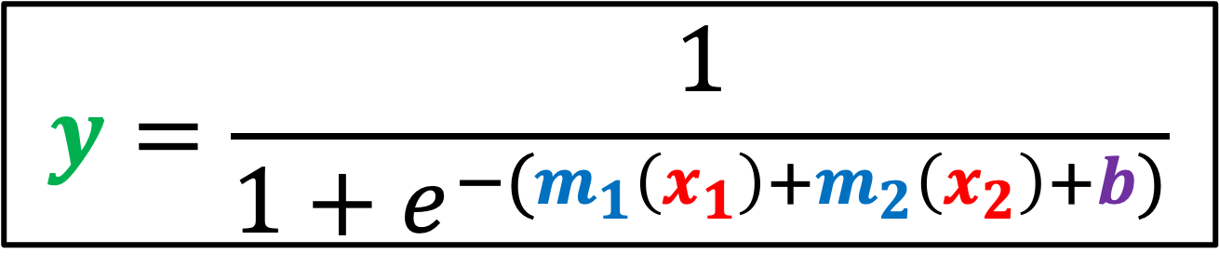
$$y=\frac{1}{1+e^{−(m_{1}\left(x_{1}\right)+m_{2}\left(x_{2}\right)+b)}}$$
Because we now have two independent variables, we need to extend this equation

Slide 33
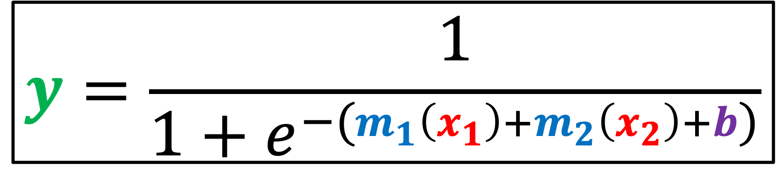
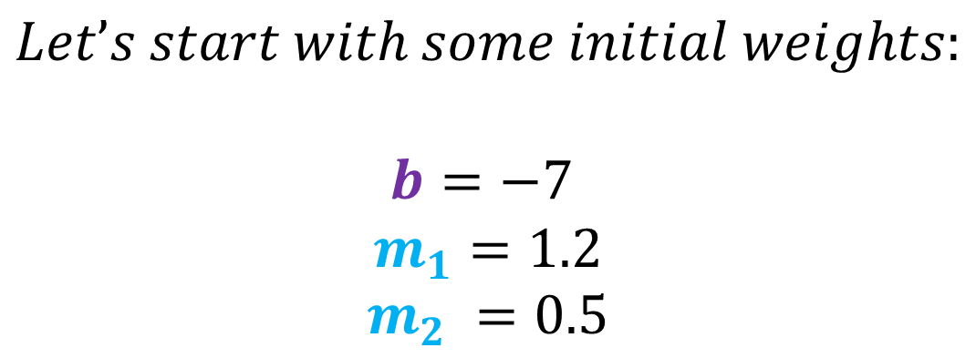
$$y=\frac{1}{1+e^{−(m_{1}\left(x_{1}\right)+m_{2}\left(x_{2}\right)+b)}}$$
$$Let’s start with some initial weights:$$
$$b=−7$$
$$m_{1}=1.2$$
$$m_{2} =0.5$$

Slide 34
Step 2:
Compute probabilities

Slide 35
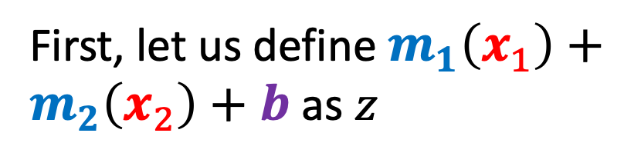
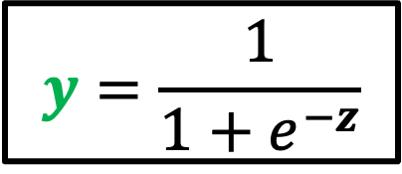
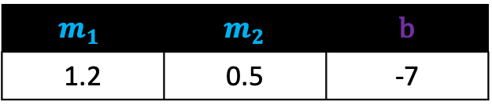
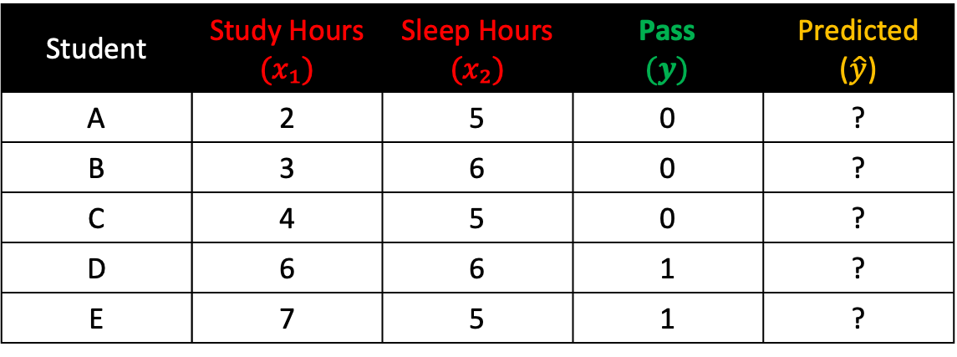
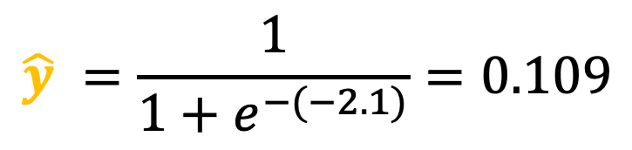
Compute the probability of Student A
First, let us define $m_{1}\left(x_{1}\right)+m_{2}\left(x_{2}\right)+b$ as $z$
Student | Study Hours $(x₁)$ | Sleep Hours $(x₂)$ | Pass $$(y)$$ | Predicted ($\hat{y}$)
A | 2 | 5 | 0 | ?
B | 3 | 6 | 0 | ?
C | 4 | 5 | 0 | ?
D | 6 | 6 | 1 | ?
E | 7 | 5 | 1 | ?
$$z=1.2\left(2\right)+0.5\left(5\right)+\left(−7\right)=−2.1$$
$$m_{1}$$ | $m_{2}$ | b
1.2 | 0.5 | -7
1
$$y=\frac{1}{1+e^{−z}}$$
2
$$\hat{y} ​=\frac{1}{{1+e}^{−(−2.1)}}=0.109$$
3

Slide 36
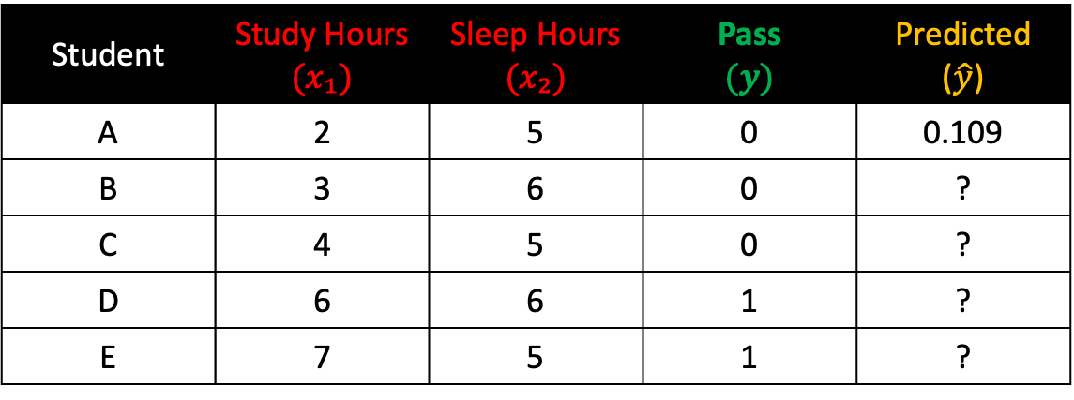

Compute the probability of Student B
First, let us define $m_{1}\left(x_{1}\right)+m_{2}\left(x_{2}\right)+b$ as $z$
Student | Study Hours $(x₁)$ | Sleep Hours $(x₂)$ | Pass $$(y)$$ | Predicted ($\hat{y}$)
A | 2 | 5 | 0 | 0.109
B | 3 | 6 | 0 | ?
C | 4 | 5 | 0 | ?
D | 6 | 6 | 1 | ?
E | 7 | 5 | 1 | ?
$$z=1.2\left(3\right)+0.5\left(6\right)+\left(−7\right)=−0.4$$
$$m_{1}$$ | $m_{2}$ | b
1.2 | 0.5 | -7
1
$$y=\frac{1}{1+e^{−z}}$$
2
$$\hat{y} ​=\frac{1}{{1+e}^{−(−0.4)}}=0.401$$
3

Slide 37
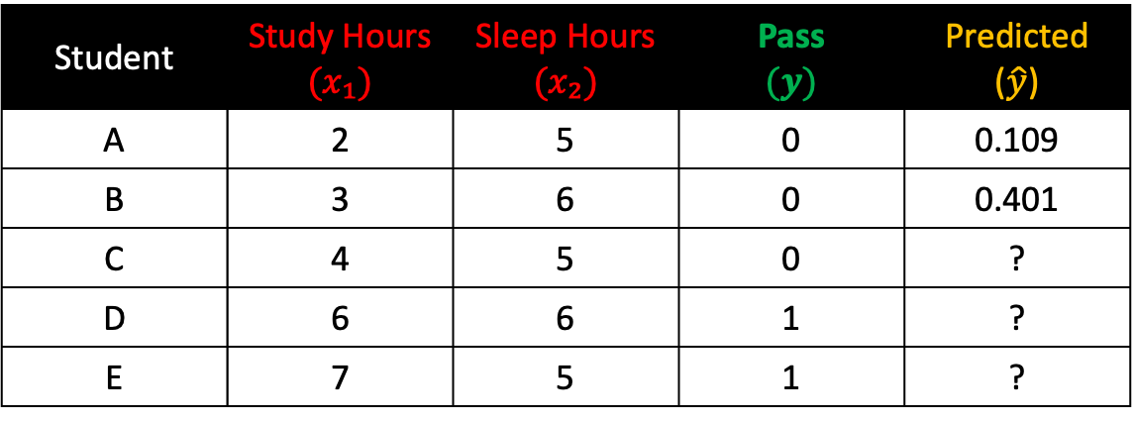
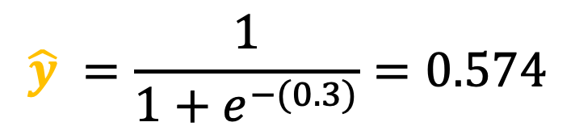
Compute the probability of Student C
First, let us define $m_{1}\left(x_{1}\right)+m_{2}\left(x_{2}\right)+b$ as $z$
Student | Study Hours $(x₁)$ | Sleep Hours $(x₂)$ | Pass $$(y)$$ | Predicted ($\hat{y}$)
A | 2 | 5 | 0 | 0.109
B | 3 | 6 | 0 | 0.401
C | 4 | 5 | 0 | ?
D | 6 | 6 | 1 | ?
E | 7 | 5 | 1 | ?
$$z=1.2\left(4\right)+0.5\left(5\right)+\left(−7\right)=0.3$$
$$m_{1}$$ | $m_{2}$ | b
1.2 | 0.5 | -7
1
$$y=\frac{1}{1+e^{−z}}$$
2
$$\hat{y} ​=\frac{1}{{1+e}^{−(0.3)}}=0.574$$
3

Slide 38


Compute the probability of Student D
First, let us define $m_{1}\left(x_{1}\right)+m_{2}\left(x_{2}\right)+b$ as $z$
Student | Study Hours $(x₁)$ | Sleep Hours $(x₂)$ | Pass $$(y)$$ | Predicted ($\hat{y}$)
A | 2 | 5 | 0 | 0.109
B | 3 | 6 | 0 | 0.401
C | 4 | 5 | 0 | 0.574
D | 6 | 6 | 1 | ?
E | 7 | 5 | 1 | ?
$$z=1.2\left(6\right)+0.5\left(6\right)+\left(−7\right)=3.2$$
$$m_{1}$$ | $m_{2}$ | b
1.2 | 0.5 | -7
1
$$y=\frac{1}{1+e^{−z}}$$
2
$$\hat{y} ​=\frac{1}{{1+e}^{−(3.2)}}=0.961$$
3

Slide 39
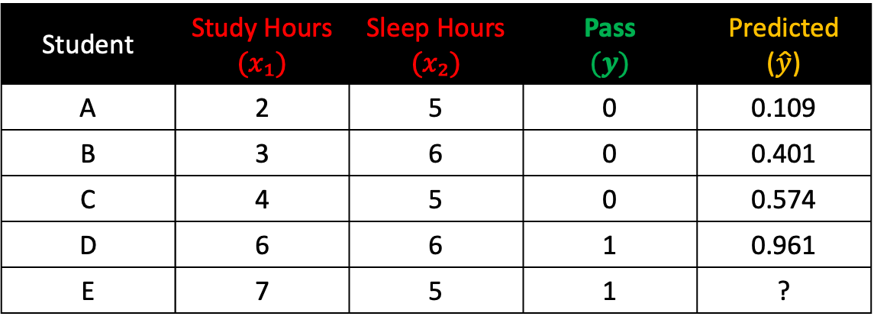

Compute the probability of Student E
First, let us define $m_{1}\left(x_{1}\right)+m_{2}\left(x_{2}\right)+b$ as $z$
Student | Study Hours $(x₁)$ | Sleep Hours $(x₂)$ | Pass $$(y)$$ | Predicted ($\hat{y}$)
A | 2 | 5 | 0 | 0.109
B | 3 | 6 | 0 | 0.401
C | 4 | 5 | 0 | 0.574
D | 6 | 6 | 1 | 0.961
E | 7 | 5 | 1 | ?
$$z=1.2\left(7\right)+0.5\left(5\right)+\left(−7\right)=3.9$$
$$m_{1}$$ | $m_{2}$ | b
1.2 | 0.5 | -7
1
$$y=\frac{1}{1+e^{−z}}$$
2
$$\hat{y} ​=\frac{1}{{1+e}^{−(3.9)}}=0.980$$
3

Slide 40
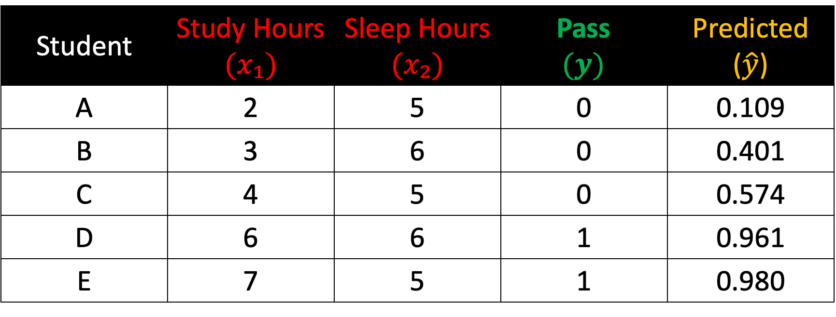
Prediction Results
Student | Study Hours $(x₁)$ | Sleep Hours $(x₂)$ | Pass $$(y)$$ | Predicted ($\hat{y}$)
A | 2 | 5 | 0 | 0.109
B | 3 | 6 | 0 | 0.401
C | 4 | 5 | 0 | 0.574
D | 6 | 6 | 1 | 0.961
E | 7 | 5 | 1 | 0.980

Slide 41
Step 3:
Compute Loss

Slide 42
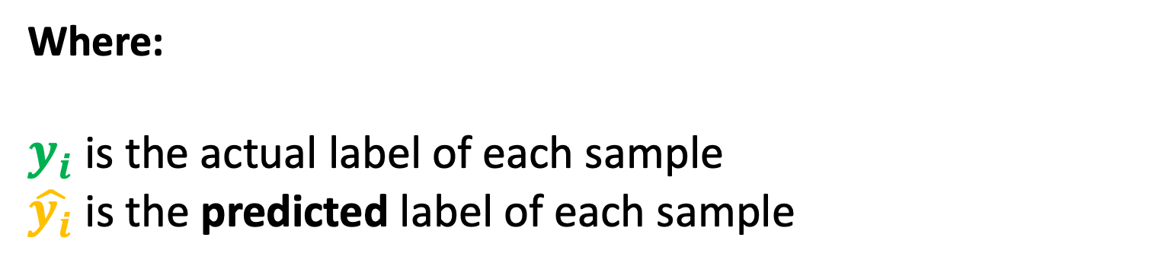
Computing Loss (Binary Cross-Entropy)
$${loss}_{i}=−(y_{i} × \ln{(\hat{y_{i}})}+\left(1−y_{i}\right) × ln⁡(1−\hat{y_{i}}))$$
Where:
$y_{i}$ is the actual label of each sample
$\hat{y_{i}}$is the predicted label of each sample

Slide 43

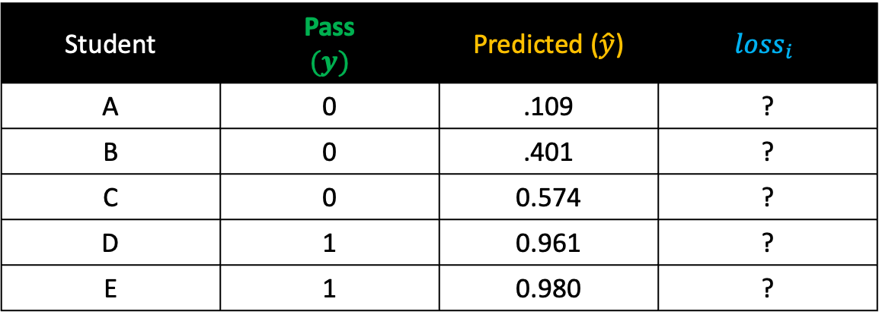


Compute the loss of Student A
Student | Pass $$(y)$$ | Predicted ($\hat{y}$) | $${loss}_{i}$$
A | 0 | .109 | ?
B | 0 | .401 | ?
C | 0 | 0.574 | ?
D | 1 | 0.961 | ?
E | 1 | 0.980 | ?
$${loss}_{i}=−(y_{i} × \ln{(\hat{y_{i}})}+\left(1−y_{i}\right) × ln⁡(1−\hat{y_{i}}))$$
1
$${loss}_{i}=−(0 × ln⁡(0.109)+\left(1−0\right) × ln⁡(1−0.109))$$
2
$${loss}_{i}=−(0+1 × ln⁡(1−0.109))$$
3
$${loss}_{i}=−(ln\left(1−0.109)\right)$$
4
$${loss}_{i}=−\ln\left(0.8909\right)=0.1155$$

Slide 44

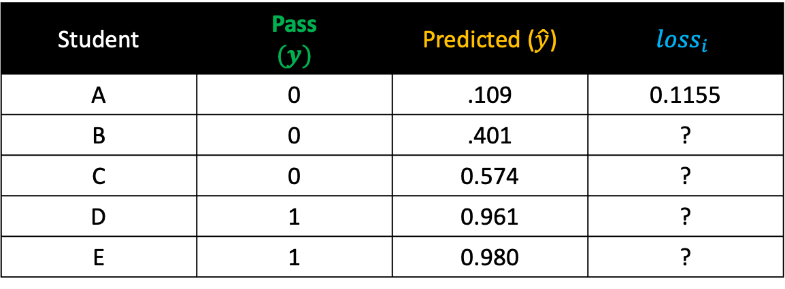


Compute the loss of Student B
Student | Pass $$(y)$$ | Predicted ($\hat{y}$) | $${loss}_{i}$$
A | 0 | .109 | 0.1155
B | 0 | .401 | ?
C | 0 | 0.574 | ?
D | 1 | 0.961 | ?
E | 1 | 0.980 | ?
$${loss}_{i}=−(y_{i} × \ln{(\hat{y_{i}})}+\left(1−y_{i}\right) × ln⁡(1−\hat{y_{i}}))$$
1
$${loss}_{i}=−(0 × ln⁡(0.401)+\left(1−0\right) × ln⁡(1−0.401))$$
2
$${loss}_{i}=−(0+1 × ln⁡(1−0.401))$$
3
$${loss}_{i}=−\ln\left(1−0.401\right)$$
4
$${loss}_{i}=−\ln\left(0.5987\right)=0.5130$$

Slide 45




Compute the loss of Student C
Student | Pass $$(y)$$ | Predicted ($\hat{y}$) | $${loss}_{i}$$
A | 0 | .109 | 0.1155
B | 0 | .401 | 0.5130
C | 0 | 0.574 | ?
D | 1 | 0.961 | ?
E | 1 | 0.980 | ?
$${loss}_{i}=−(y_{i} × \ln{(\hat{y_{i}})}+\left(1−y_{i}\right) × ln⁡(1−\hat{y_{i}}))$$
1
$${loss}_{i}=−(0 × ln⁡(0.574)+\left(1−0\right) × ln⁡(1−0.574))$$
2
$${loss}_{i}=−(0+1 × ln⁡(1−0.574))$$
3
$${loss}_{i}=−\ln\left(1−0.574\right)$$
4
$${loss}_{i}=−\ln\left(0.4256\right)=0.8544$$

Slide 46
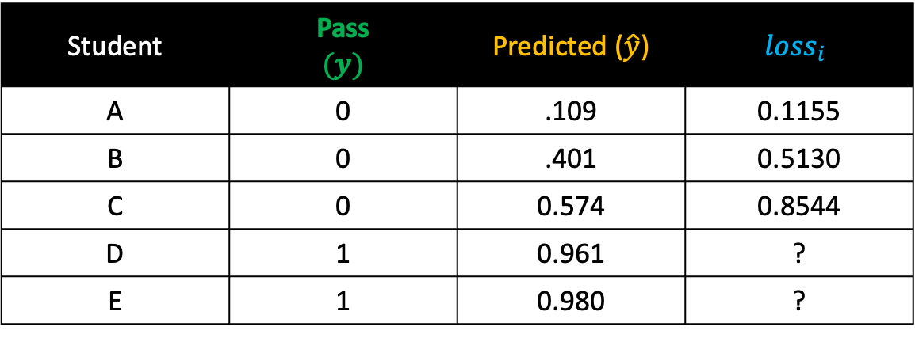


Compute the loss of Student D
Student | Pass $$(y)$$ | Predicted ($\hat{y}$) | $${loss}_{i}$$
A | 0 | .109 | 0.1155
B | 0 | .401 | 0.5130
C | 0 | 0.574 | 0.8544
D | 1 | 0.961 | ?
E | 1 | 0.980 | ?
$${loss}_{i}=−(y_{i} × \ln{(\hat{y_{i}})}+\left(1−y_{i}\right) × ln⁡(1−\hat{y_{i}}))$$
1
$${loss}_{i}=−(1 × ln⁡(0.961)+\left(1−1\right) × ln⁡(1−0.961))$$
2
${loss}_{i}=−\left(\ln\left(0.961\right)+0 × ln⁡(1−0.961)\right)$
3
$${loss}_{i}=−\ln\left(0.961\right)$$
4
$${loss}_{i}=0.0396$$

Slide 47
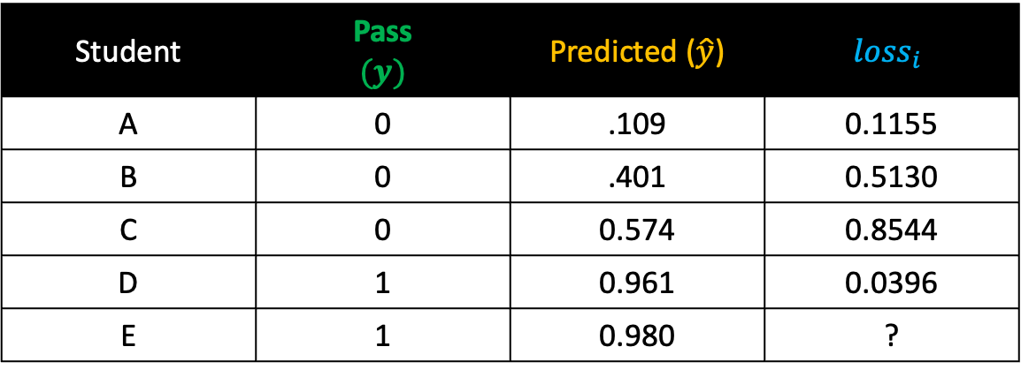


Compute the loss of Student E
Student | Pass $$(y)$$ | Predicted ($\hat{y}$) | $${loss}_{i}$$
A | 0 | .109 | 0.1155
B | 0 | .401 | 0.5130
C | 0 | 0.574 | 0.8544
D | 1 | 0.961 | 0.0396
E | 1 | 0.980 | ?
$${loss}_{i}=−(y_{i} × \ln{(\hat{y_{i}})}+\left(1−y_{i}\right) × ln⁡(1−\hat{y_{i}}))$$
1
$${loss}_{i}=−(1 × ln⁡(0.980)+\left(1−1\right) × ln⁡(1−0.980))$$
2
$${loss}_{i}=−(\ln\left(0.980\right)+0 × ln⁡(1−0.980))$$
3
$${loss}_{i}=−\ln\left(0.980\right)$$
4
$${loss}_{i}=0.02004$$

Slide 48
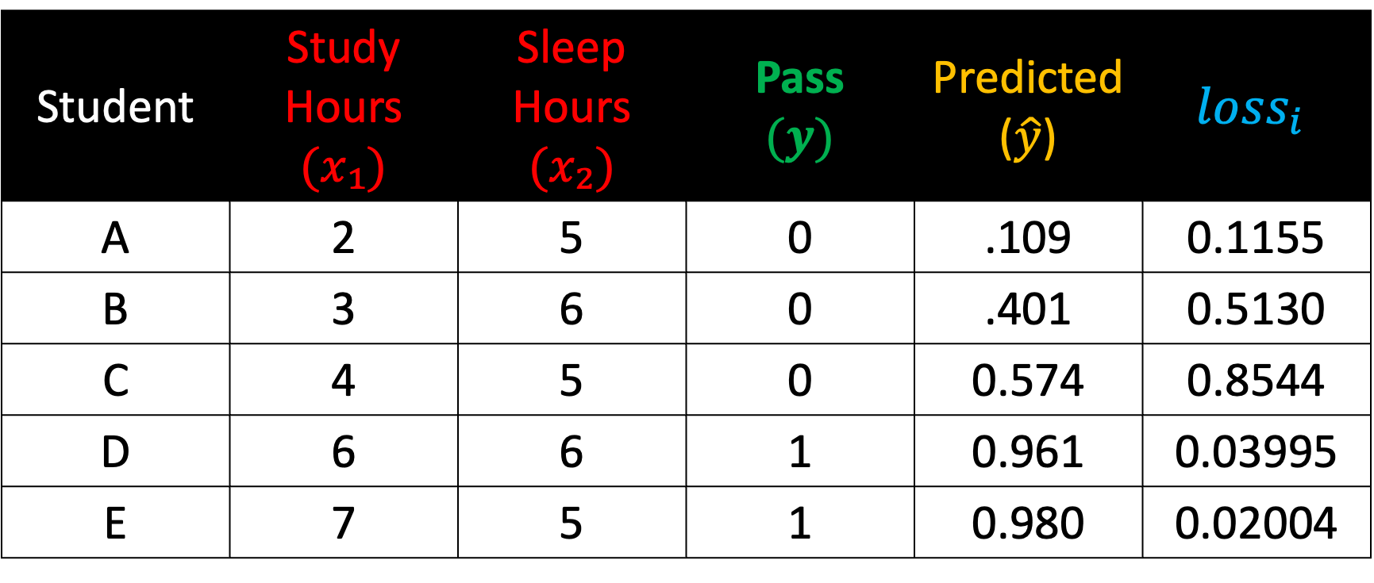
Computing Loss (Binary Cross-Entropy)
Student | Study Hours $(x₁)$ | Sleep Hours $(x₂)$ | Pass $$(y)$$ | Predicted ($\hat{y}$) | $${loss}_{i}$$
A | 2 | 5 | 0 | .109 | 0.1155
B | 3 | 6 | 0 | .401 | 0.5130
C | 4 | 5 | 0 | 0.574 | 0.8544
D | 6 | 6 | 1 | 0.961 | 0.03995
E | 7 | 5 | 1 | 0.980 | 0.02004

Slide 49
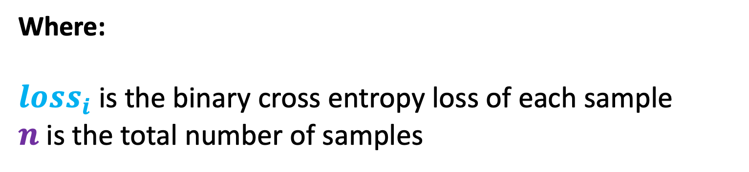
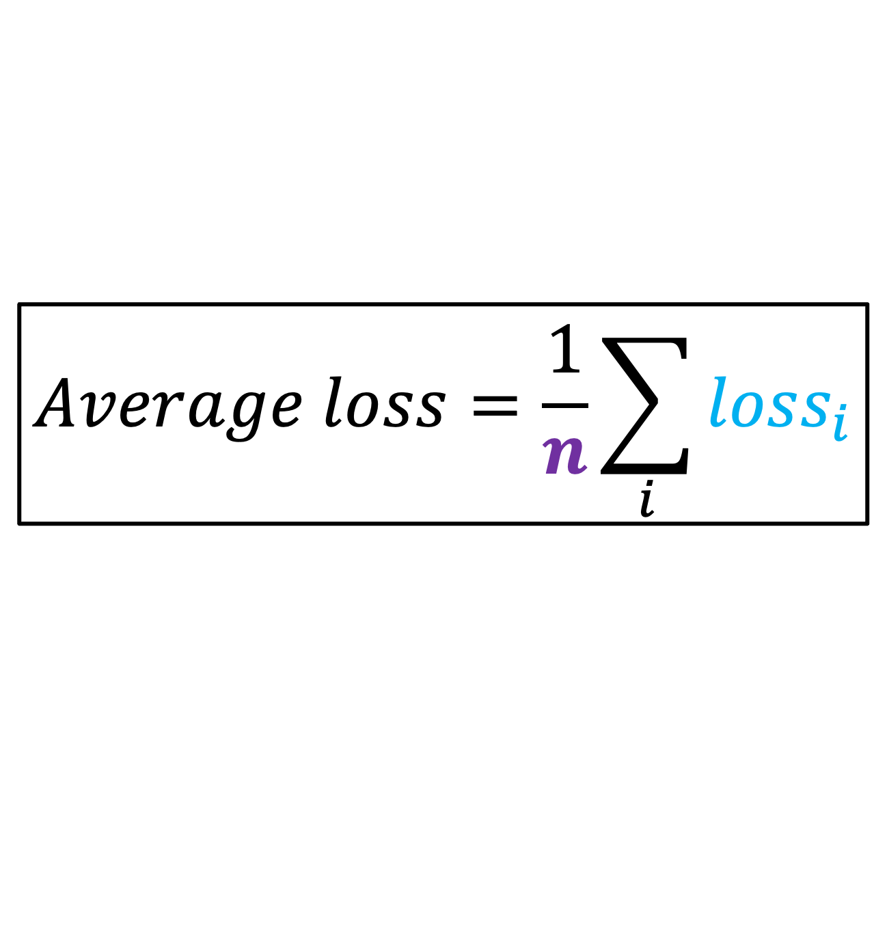
Compute the Average Loss
$$Average loss=\frac{1}{n}\sum_{i}{{loss}_{i}}$$
Where:
${loss}_{i}$ is the binary cross entropy loss of each sample
$n$is the total number of samples

Slide 50
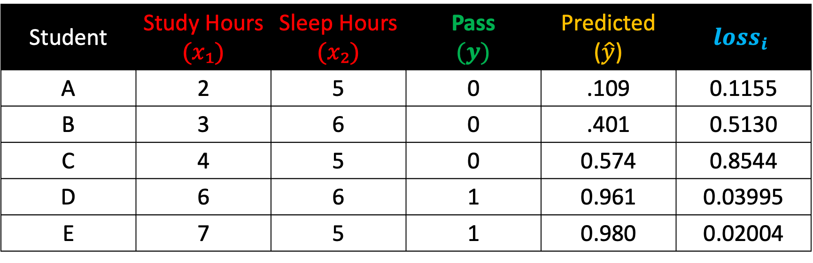
Compute the Average Loss
Student | Study Hours $(x₁)$ | Sleep Hours $(x₂)$ | Pass $$(y)$$ | Predicted ($\hat{y}$) | $${loss}_{i}$$
A | 2 | 5 | 0 | .109 | 0.1155
B | 3 | 6 | 0 | .401 | 0.5130
C | 4 | 5 | 0 | 0.574 | 0.8544
D | 6 | 6 | 1 | 0.961 | 0.03995
E | 7 | 5 | 1 | 0.980 | 0.02004
$$Average loss=\frac{0.1155+0.5130+0.8544+0.03995+0.02004​}{5}=\frac{1.54​}{5}=0.3086$$

Slide 51
Step 5:
Find the optimal slope and intercept

Slide 52
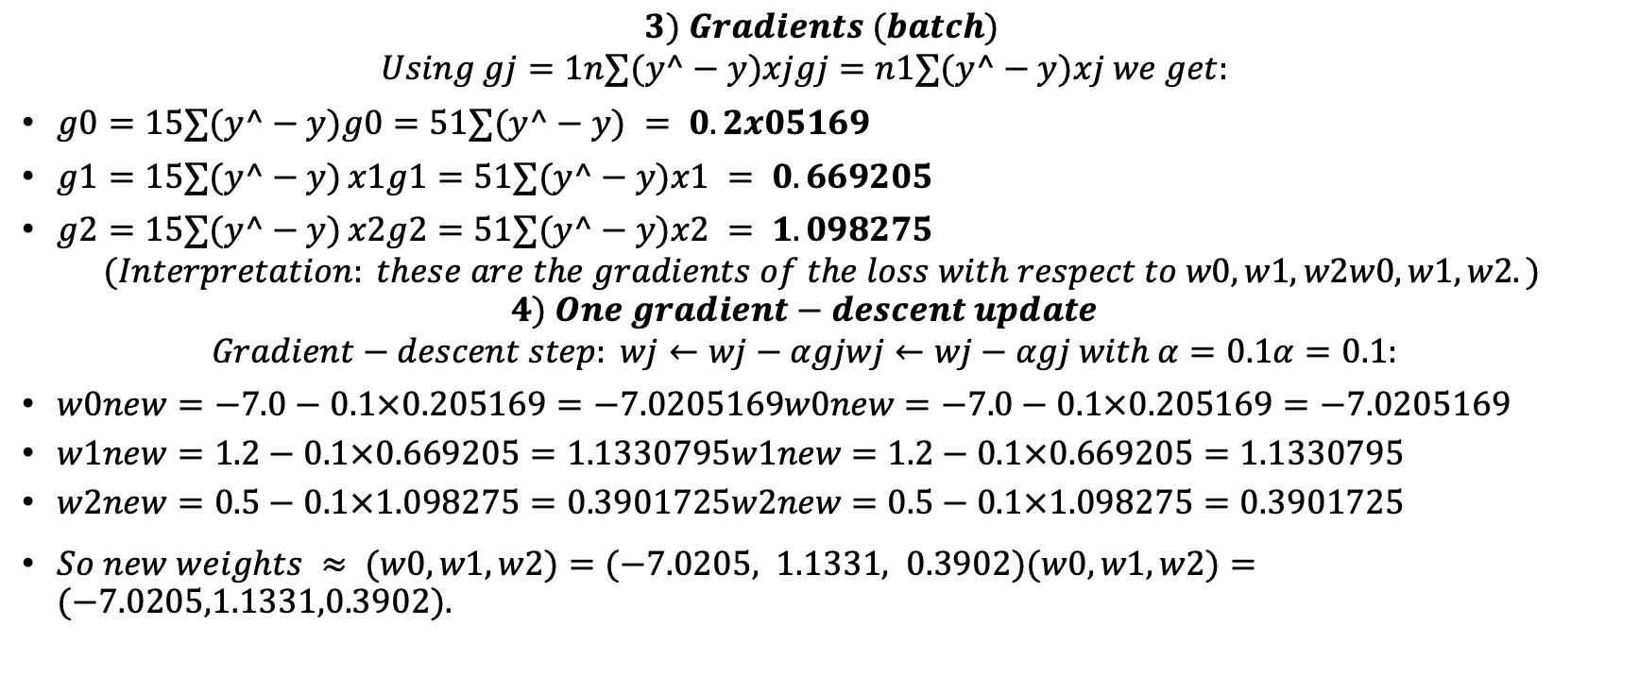
$$3) Gradients (batch)$$
$$Using gj=1n∑(y^−y)xjgj​=n1​∑(y^​−y)xj​ we get:$$
$g0=15∑(y^−y)g0​=51​∑(y^​−y) = 0.2x05169$
$g1=15∑(y^−y) x1g1​=51​∑(y^​−y)x1​ = 0.669205$
$g2=15∑(y^−y) x2g2​=51​∑(y^​−y)x2​ = 1.098275$
$$(Interpretation: these are the gradients of the loss with respect to w0,w1,w2w0​,w1​,w2​.)$$
$$4) One gradient−descent update$$
$$Gradient−descent step: wj←wj−αgjwj​←wj​−αgj​ with α=0.1α=0.1:$$
$w0new=−7.0−0.1×0.205169=−7.0205169w0new​=−7.0−0.1×0.205169=−7.0205169$
$w1new=1.2−0.1×0.669205=1.1330795w1new​=1.2−0.1×0.669205=1.1330795$
$w2new=0.5−0.1×1.098275=0.3901725w2new​=0.5−0.1×1.098275=0.3901725$
$So new weights ≈ (w0,w1,w2)=(−7.0205, 1.1331, 0.3902)(w0​,w1​,w2​)=(−7.0205,1.1331,0.3902).$

Slide 53
Student | znew | y^new
A | -2.8035 | 0.05714
B | -1.2802 | 0.21751
C | -0.5373 | 0.36881
D | 2.1190 | 0.89274
E | 2.8619 | 0.94593

Slide 54
A: 0.05883
B: 0.24527
C: 0.46014
D: 0.11346
E: 0.05559
Average new loss Lnew≈0.18666Lnew​≈0.18666.

Slide 55
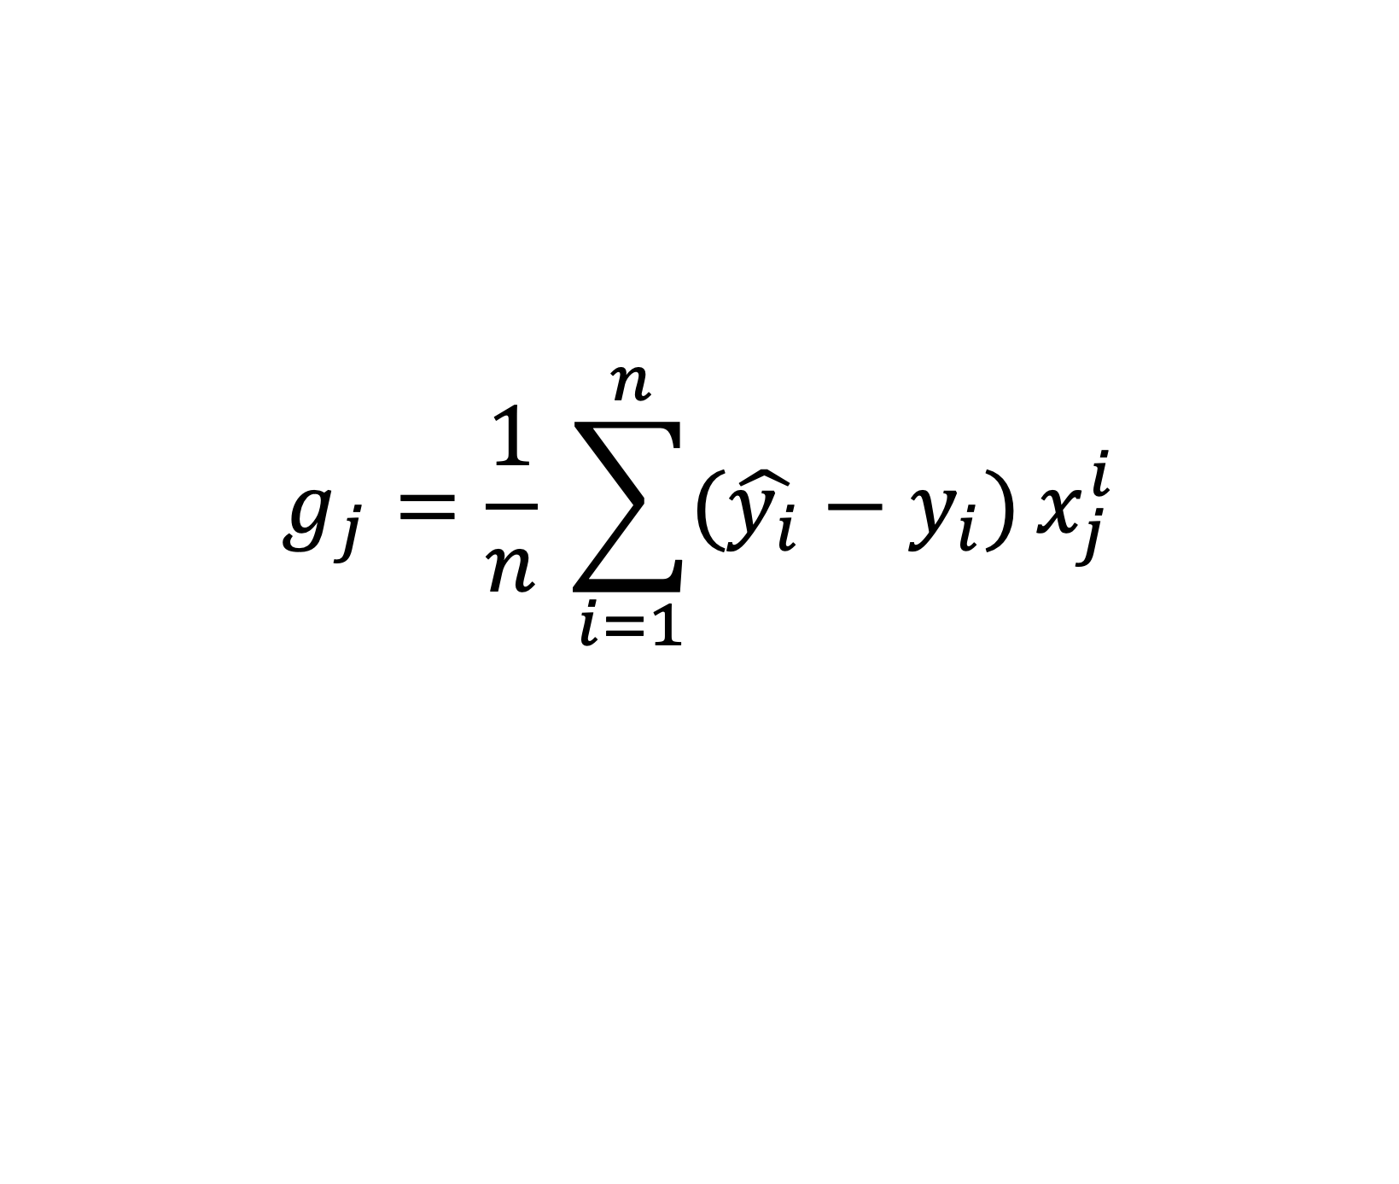
Gradient of the loss w.r.t to weight
$$g_{j}​=\frac{1}{n} \sum_{i=1}^{n}{(\hat{y_{i}}−y_{i})}x_{j}^{i}$$

Slide 56
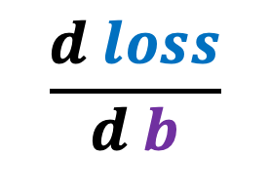
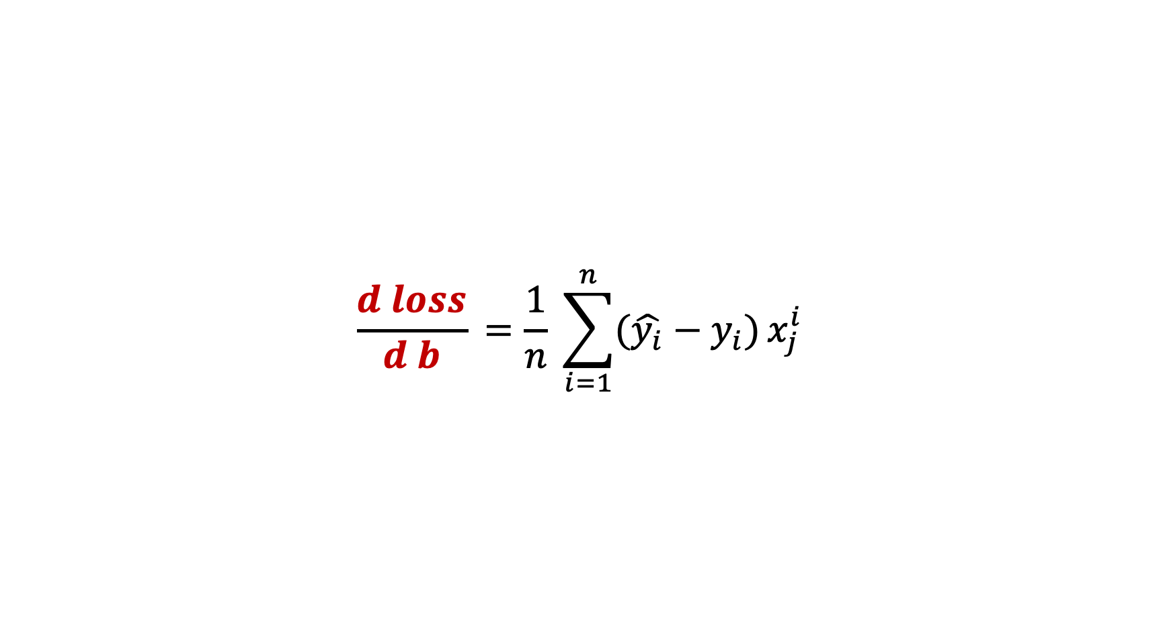
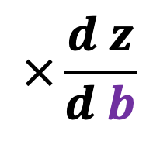
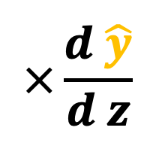
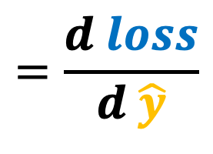
$$\frac{d loss}{d b}​=\frac{1}{n} \sum_{i=1}^{n}{(\hat{y_{i}}−y_{i})}x_{j}^{i}$$
$$\frac{d loss}{d b}$$
$$=\frac{d loss}{d \hat{y}}$$
$$×\frac{d \hat{y}}{d z}$$
$$×\frac{d z}{d b}$$

Slide 57
$$\frac{d loss}{d b}​=\frac{1}{n} \sum_{i=1}^{n}{(\hat{y_{i}}−y_{i})}x_{j}^{i}$$
$$\frac{d loss}{d b}$$
$$=\frac{d loss}{d \hat{y}}$$
$$×\frac{d \hat{y}}{d z}$$
$$×\frac{d z}{d b}$$

Slide 58
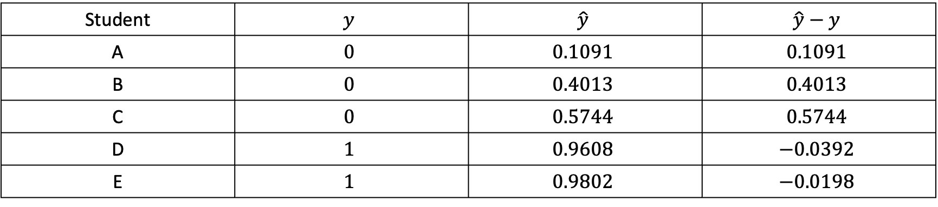
Student | $$y$$ | $$\hat{y}$$ | $$\hat{y}−y$$
A | $$0$$ | $$0.1091$$ | $$0.1091$$
B | $$0$$ | $$0.4013$$ | $$0.4013$$
C | $$0$$ | $$0.5744$$ | $$0.5744$$
D | $$1$$ | $$0.9608$$ | $$−0.0392$$
E | $$1$$ | $$0.9802$$ | $$−0.0198$$

Slide 59
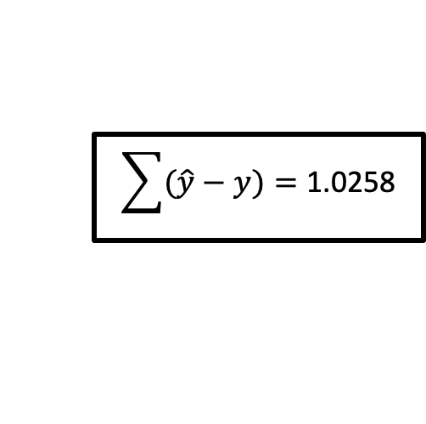
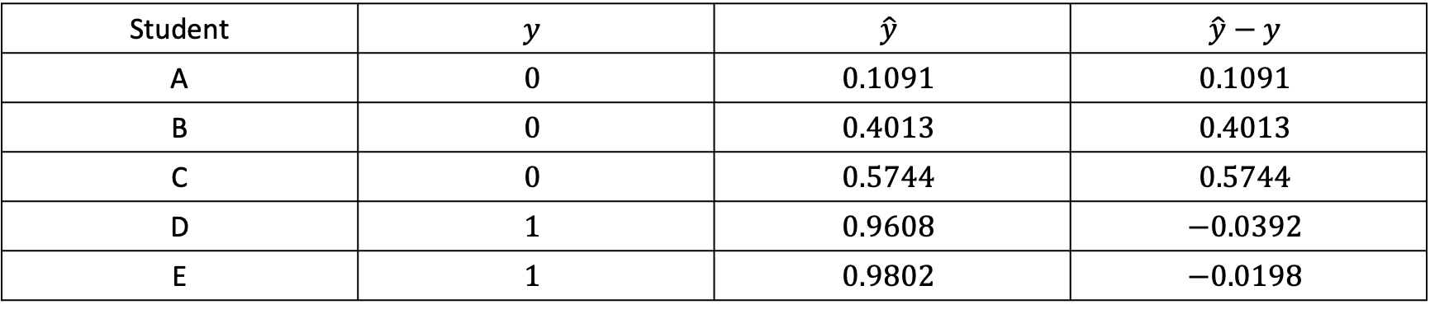
Student | $$y$$ | $$\hat{y}$$ | $$\hat{y}−y$$
A | $$0$$ | $$0.1091$$ | $$0.1091$$
B | $$0$$ | $$0.4013$$ | $$0.4013$$
C | $$0$$ | $$0.5744$$ | $$0.5744$$
D | $$1$$ | $$0.9608$$ | $$−0.0392$$
E | $$1$$ | $$0.9802$$ | $$−0.0198$$
$$\sum{(\hat{y}−y)}=\text{1.0258}$$

Slide 60
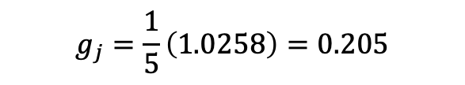
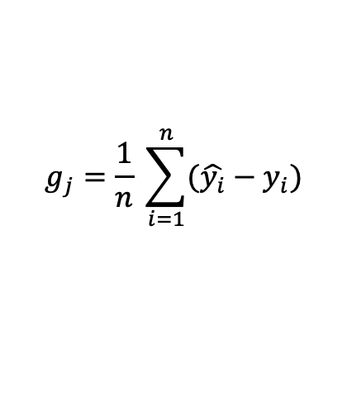
Student | $$y$$ | $$\hat{y}$$ | $$\hat{y}−y$$
A | $$0$$ | $$0.1091$$ | $$0.1091$$
B | $$0$$ | $$0.4013$$ | $$0.4013$$
C | $$0$$ | $$0.5744$$ | $$0.5744$$
D | $$1$$ | $$0.9608$$ | $$−0.0392$$
E | $$1$$ | $$0.9802$$ | $$−0.0198$$
$$\sum{(\hat{y}−y)}=\text{1.0258}$$
$$g_{j}​=\frac{1}{n} \sum_{i=1}^{n}{(\hat{y_{i}}−y_{i})}$$
$$g_{j}​=\frac{1}{5}\left(1.0258\right)=0.205$$

Slide 61
References
https://www.youtube.com/watch?v=yIYKR4sgzI8&list=PLblh5JKOoLUKxzEP5HA2d-Li7IJkHfXSe&index=1

